Slide 1
Tobacco

Slide 3
Tobacco Use Among High School Students in 2014
Tobacco Use* Among High School Students in 20145
Tobacco Product | Overall | Females | Males
Any tobacco product† | 24.6% | 20.9% | 28.3%
Electronic cigarettes | 13.4% | 11.9% | 15.0%
Hookahs | 9.4% | 9.8% | 8.9%
Cigarettes | 9.2% | 7.9% | 10.6%
Cigars | 8.2% | 5.5% | 10.8%
Smokeless tobacco | 5.5% | 1.2% | 9.9%
Snus | 1.9% | 0.8% | 3.0%
Pipes | 1.5% | 0.9% | 2.1%
Bidis | 0.9% | 0.6% | 1.2%
Dissolvable tobacco | 0.6% | 0.4% | 0.8%

Slide 4
Commercial
Watch this commercial.
https://www.youtube.com/watch?v=56b09ZyLaWk
Who is the target audience and why?

Slide 5
Examining Advertising Tactics
Identify the tactic being used to sell the product.
Humor
Slogan and jingles
Testimonials
Attractive models
Positive Images
Bandwagon approach
Appeal to the senses
Price appeal

Slide 6
Examining Advertising Tactics
Identify the ad’s target audience.
In what setting does the add take place?
What are the characters in the as doing?
Where does the ad appear?
Identify the ad’s message.
What the ad wants you to believe about the product. Do you think it could be true?

Slide 7
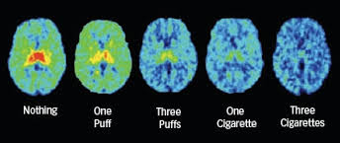
Nicotine in the Body
Stimulants are drugs that increase the activity of the nervous system.
Once in the blood, nicotine reaches the brain within seconds.
By mimicking neurotransmitters, nicotine affects breathing, movement, learning, mood and appetite.
Short-term effects of nicotine use…
Increased heart rate
Increased blood pressure
Changes in the brain that may lead to addiction.

Slide 8
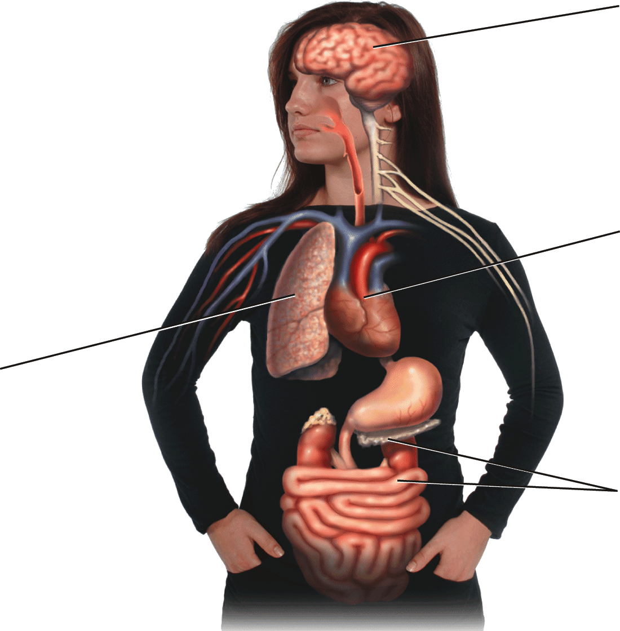
Effects of Nicotine
Nervous System
• Increases activity level
• Mimics neurotransmitters
• Decreases some reflex actions
• Activates the brain’s “reward pathway”
Cardiovascular System
• Increases heart rate and the force of contractions
• Increases blood pressure
• Reduces blood flow to skin
• Increases risk of blood clotting
Respiratory System
• Increases mucus production
• Decreases muscle action in the lungs’ airways
• Causes breathing to become more shallow
Digestive System
• Increases saliva production
• Decreases the amount of insulin released from the pancreas
• Increases bowel activity

Slide 9
Nicotine Addiction
On going use of nicotine allows the body to develop tolerance to nicotine.
As tolerance increases, nicotine addiction develops
The time it takes to become addicted depends on several factors including genetics, frequency of use, and age.
Studies show teens become addicted faster and more intensely than adults.
Psychological dependence
Tobacco use may become a habit to use to cope with stressful situations.
Tobacco may be associated with social situations.

Slide 10
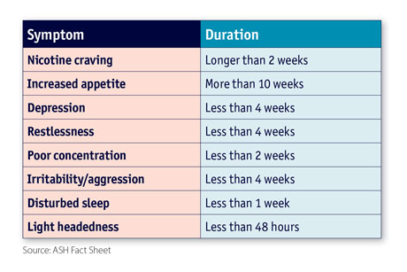
Symptoms of Nicotine Withdrawal
Symptoms of Nicotine withdrawal include…
Headaches
Irritability
Difficulty Sleeping
Inability to concentrate
Intense nicotine cravings

Slide 11
Chemicals in Tobacco
There are over 7000 chemical found in a tobacco smoke. Hundreds of them are toxic, and 70 of them can cause cancer. Here are a few examples.
Arsenic
Benzene
Formaldehyde
Chemical found in pesticides.
Chemical found in gasoline.
Used to embalm dead bodies.

Slide 12
Chemicals In Tobacco
Lead
Cadmium
Butane
Element once found in paint.
Element used in batteries.
A chemical found in lighters.

Slide 13
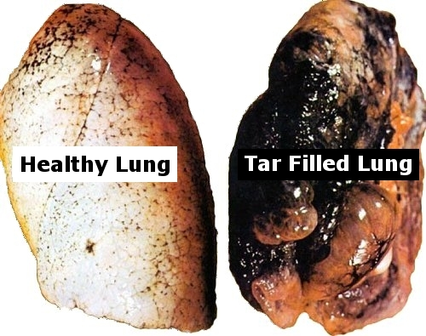
Tar
The dark, sticky substance that forms when tobacco is burned is called tar.
Tar contains many chemicals known as carcinogens, or cancer causing agents.
Short term effects of Tar:
Brown stains on fingers and teeth
Smelly hair and clothing
Bad breath
Paralysis of cilia lining the airway.
Increased number of respiratory infections.
Impaired lung function.
If you smoked half a pack of cigarettes everyday for a year, the tar in the jar would be the amount of tar in your lungs.
200 ml of tar.

Slide 14
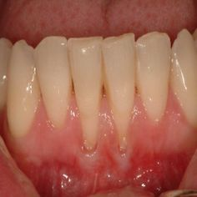
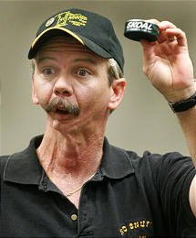
Chemicals in Smokeless Tobacco
Smokeless tobacco contains many of the same dangerous chemicals that cigarette smoke contains.
Smokeless tobacco is at least as addictive as cigarettes.
Short term effects
Stained teeth
Bad breath/drooling
Tooth decay/ receding gums

Slide 15
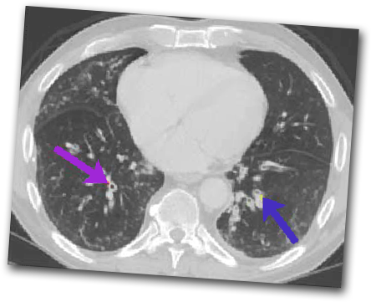
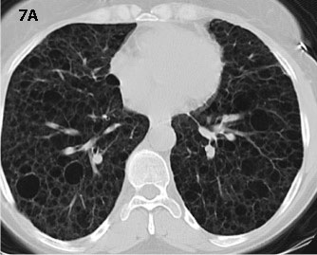
Chronic Obstructive Pulmonary Disease
Chronic Bronchitis
Emphysema
Chronic Obstructive Pulmonary Disease
The airways (bronchial tubes) are constantly inflamed and full of mucus.
A disorder in which alveoli in the lungs are irritated and can no longer function properly so it is difficult to breathe and for blood to get oxygen.
COPD is a disease that results in gradual loss of lung function which makes it hard to breathe. Coughing up mucus is often the first sign of Chronic Obstructive Pulmonary Disease
Chronic Bronchitis and Emphysema are both COPD’s
Purple arrow shows thickening of bronchial walls and blue arrow shows bronchi filled with mucus.

Slide 17
Cardiovascular Disease
The combined effects of nicotine, tar, and carbon monoxide force the cardiovascular system to work harder to deliver oxygen throughout the body.
Tobacco use raises blood pressure
Studies show that the chemicals in tobacco smoke increase blood cholesterol levels and promote atherosclerosis.
Nicotine increases the blood’s tendency to clot.

Slide 18
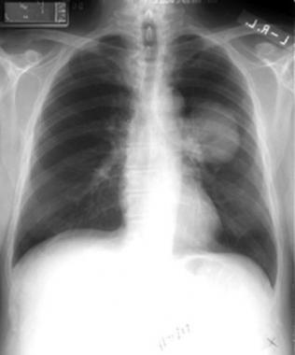
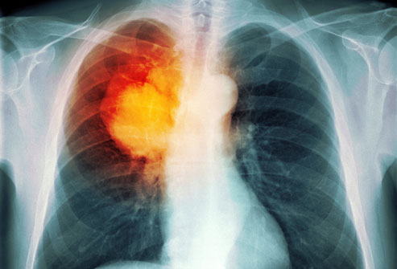
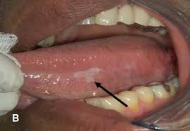
Cancers
Tobacco use is a major factor in the development of lung cancer and oral cancers.
Other cancers
Oral
Esophagus
Larynx
Stomach
Pancreas
Kidney
Bladder
Blood

Slide 19
Dangers of Secondhand Smoke
Long-term exposure to secondhand smoke can cause cardiovascular disease, many respiratory problems, and cancer
Each year, secondhand smoke causes close to 40,000 deaths from heart attacks and lung cancer.
Each year, secondhand smoke contributes to about 300,000 respiratory infections in children younger than eighteen months.
Children who are exposed to secondhand smoke are more likely to develop allergies and asthma.

Slide 22
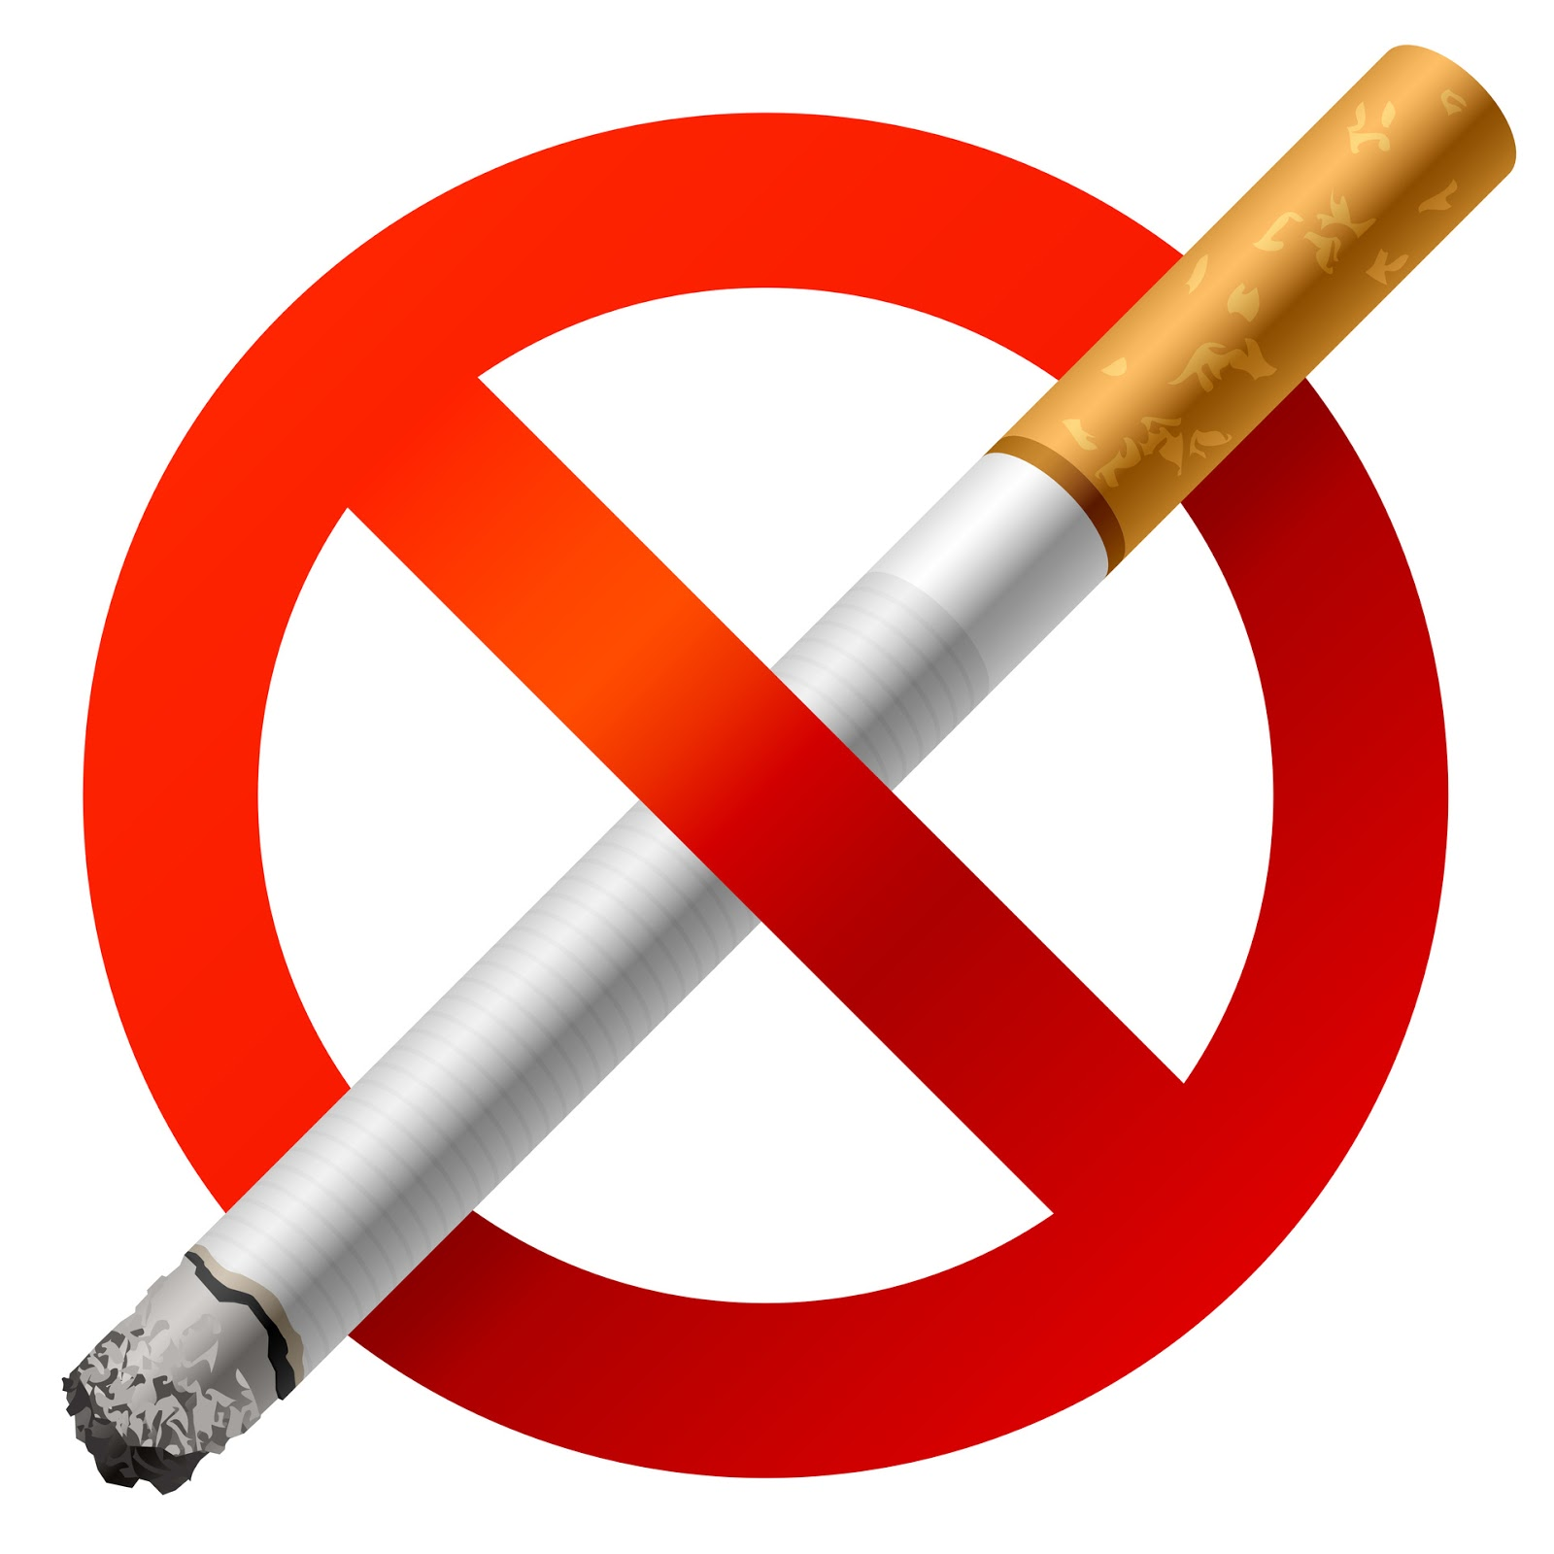
Tips for Quitting
The most important factor in successfully quitting tobacco is a strong personal commitment.
There are many things you can do to help cope with withdrawal symptoms.
Make a list of reasons why to quit.
Throw away all tobacco products and anything that reminds your of tobacco.
Do little things to change your daily routine.
Tell your family and friends that you have quit.
Avoid being around people who use tobacco.
Put aside the money you save.
Exercise or call a friend to take your mind off of smoking.

