Slide 1
Sexually Transmitted Diseases
Macomb County Health Department STD Program

Slide 2
How widespread are STDs?
Estimates:
75 Million people living in the U.S have a viral STD.
19 Million new infections occur each year.
HALF of new infections each year occur in individuals 15-24 years of age.
75% of the population will get an STD at some point in their lives
Each year 1 in 4 teens will contract a STD
1 in 2 sexually active persons will contract a STD by age 25

Slide 3
What About Macomb County?
Several sexually transmitted diseases are reportable by law and must be reported to the Health Dept.
Macomb County statistics reveal an increasing trend:
Thousands of individuals each year are undiagnosed or untreated because:
They do NOT have symptoms
They do NOT want to be tested
They do NOT follow up to seek treatment
 | 2017 | 2012
Chlamydia | 3,598 | 2,393
Gonorrhea | 946 | 530
Syphilis | 84 | 55
HIV (new diagnosis) | 69 | 44
Notes:
Nationally, the government tracks Chlamydia, Gonorrhea Syphilis, and HIV. Individual statistics about infected persons who live in Macomb County are reported to the Macomb County Health Department.
There are thousands of residents who have these infections, and other viral STI’s that have not been diagnosed and are not reflected in these reported numbers.

Slide 4
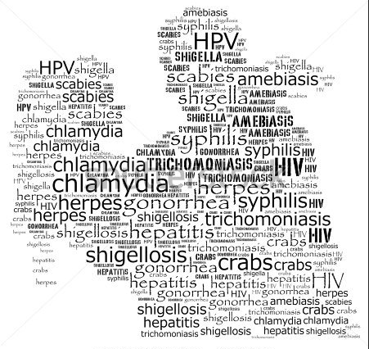
Overview of some STDs
Chlamydia
Gonorrhea
Syphilis
HIV/AIDS
Genital Warts (HPV)
Genital Herpes
Trichomoniasis
Scabies and Pubic Lice

Slide 5
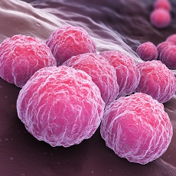
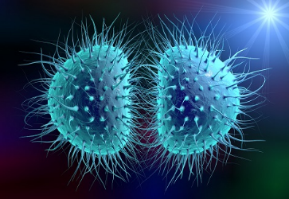
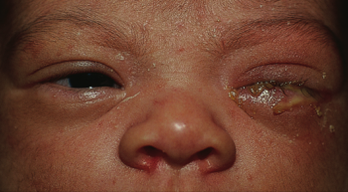
Chlamydia and Gonorrhea
Bacterial, Curable infection
3 million new cases nationwide
Transmitted through vaginal, oral or anal sexual contact with an infected partner
Pregnant women can transmit Chlamydia or Gonorrhea through vaginal delivery to their baby
Bacteria lives in vaginal fluid and semen
Many people do not know they are infected
Chlamydia
Gonorrhea
Notes:
Babies exposed to Chlamydia or Gonorrhea through vaginal delivery have a risk of lung infection and/or blindness.
Chlamydia and Gonorrhea are discussed together because their symptoms are almost identical.

Slide 6
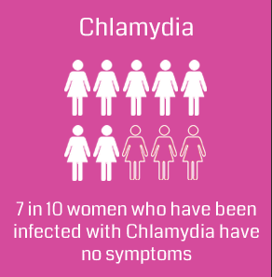
Chlamydia Symptoms
Women:
An abnormal vaginal discharge
A burning sensation when urinating
Men:
A discharge from their penis
A burning sensation when urinating
Pain and swelling in one or both testicles
(although this is less common)

Slide 7
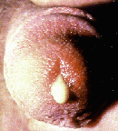
Gonorrhea Symptoms
Women:
Abnormal vaginal discharge or burning during urination
Lower abdominal pain, low back pain
Nausea, fever, pain during intercourse
Bleeding between periods
Men:
Discharge from penis or burning during urination
Burning or itching around the opening of the penis
Notes:
Note that the symptoms in women are quite a bit more vague and can be easily confused with other conditions that are not related to any STI.
The average onset of symptoms is 7-21 days for Chlamydia and 2-7 days for Gonorrhea.
Most Gonorrhea infections in males produce noticeable symptoms.

Slide 8
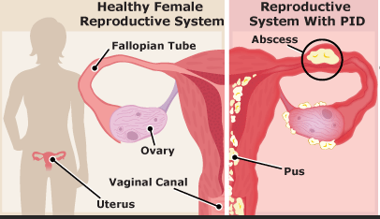
Gonorrhea Complications - Women
In women, untreated infections can spread into the uterus or fallopian tubes and cause pelvic inflammatory disease (PID)
PID can cause permanent damage leading to chronic pelvic pain, infertility and ectopic pregnancy
Notes:
The image is a sample of what PID can do to a woman’s uterus.

Slide 9
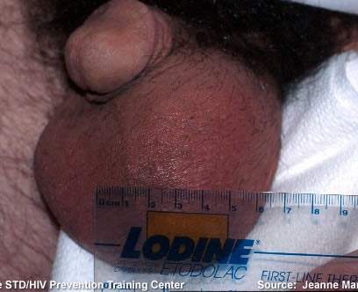
Gonorrhea Complications - Men
In men, complications are less serious
Infections can spread to the testicles causing pain, fever and occasionally sterility
Notes:
Epididymis: A structure within the scrotum attached to the backside of the testis. The epididymis is a coiled segment of the spermatic ducts that serves to store, mature and transport spermatozoa between the testis and the vas (the vas deferens).
Typical site of infection, causing the swollen testicles pictured above.
Approximately 10% of males will get this complication from Gonorrhea.

Slide 10
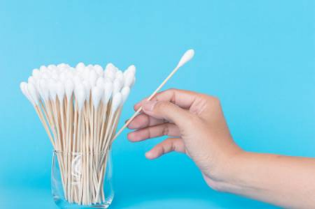
Gonorrhea & Chlamydia Testing and Treatment
Testing done through a swab of genital area or a urine test
Easily treated and cured with antibiotics.
All sex partners should be evaluated, tested and treated.
Abstain from ALL sexual intercourse until treatment is complete.

Slide 11
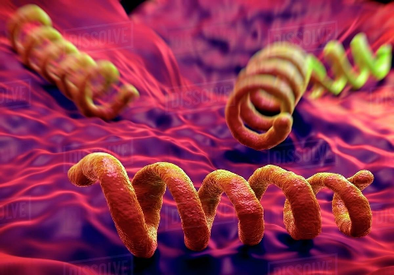
Syphilis
Bacterial, curable infection
One of the oldest known diseases
36,000 new cases nationwide
Transmission through vaginal, oral or anal intercourse – skin to skin contact during sex
Pregnant women can pass it on to their unborn child
Notes:
Unlike Chlamydia, Gonorrhea and Trichomoniasis, Syphilis is transmitted through physical contact. Intercourse, or ejaculation, does not need to occur for transmission of the disease.
Highly contagious.
Incubation period from time of contact with an infected partner to first symptoms is typically 3 weeks.

Slide 12
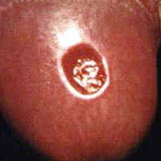
Syphilis Symptoms – Primary Stage
The start of the first symptoms is 21 days
Marked by the appearance of a sore called a “chancre”
Chancres are round, firm and painless
It appears where syphilis entered the body
Chancres last approximately 3-6 weeks
Notes:
Most individuals are infected from a partner in the first stage of the disease.
Most people will get one chancre, multiple chancres are possible.
Chancres can appear inside the vagina or on the cervix (as well as in the rectum) and would not be visible to the individual.
Testing for Syphilis – examining material from the chancre under a dark-field microscope or a blood test to detect Syphilis antibodies.

Slide 13
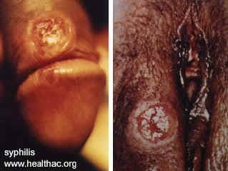
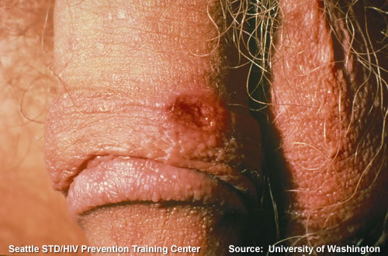
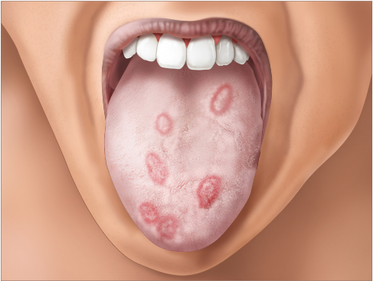
Primary Syphilis
Notes:
Primary stage syphilis chancres.

Slide 14
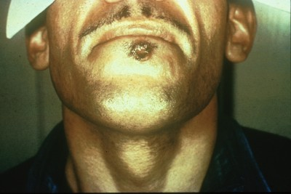
Syphilis chancre
Notes:
Syphilis chancre.

Slide 15
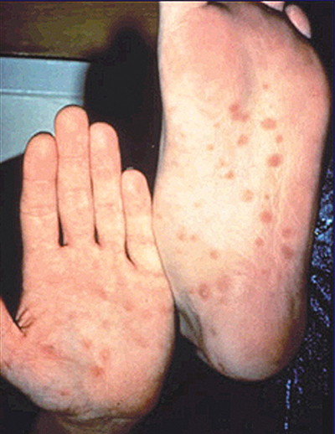
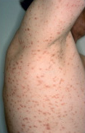
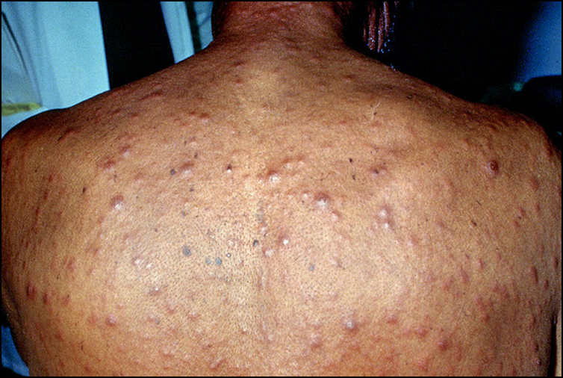
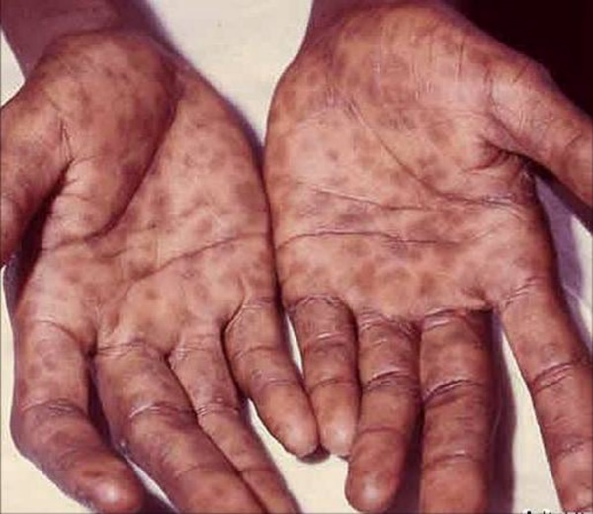
Syphilis Symptoms – Secondary Stage
Develops 3-6 weeks after the chancres appear
A rough, red or reddish brown rash that does NOT typically cause itching, lasting 2-6 weeks
Usually appears on the palms of the hands or bottoms of the feet
Other symptoms include:
fever
swollen lymph nodes
sore throat
patchy hair loss
headaches
weight loss
muscle aches and fatigue
Still contagious through sex
Symptoms will resolve without treatment but disease will remain in body
Notes:
The possibility exists for transmission in this stage as well, if an individual comes in contact with the exposed rash.
The rash will also resolve with in 6 weeks to 12 months if left untreated. Untreated secondary syphilis will progress to latent and tertiary syphilis.
Secondary syphilitic rash. Most common presentation (hands and feet).

Slide 16
Symptoms – Latent & Tertiary Stage
Latent syphilis – may not have symptoms
Without treatment latent syphilis progresses to tertiary syphilis
Tertiary syphilis – damages heart, eyes, brain, nervous system, bones and/or joints
Mental illness (Neurosyphilis), blindness, deafness, Dementia, Heart disease, Seizures
May cause death
Notes:
It takes many years to develop tertiary syphilis and its complications. The complications may not be reversible.
It is common for tertiary syphilis to produce lesions on the aorta and in the spine and brain. “Gummas” is the term used to describe growths from syphilis in the bone and skin.
Note that before there was a cure for Syphilis, most individuals went “insane” or “mad” before death. One notable individual was Al Capone (gangster, 1920’s).

Slide 17
Syphilis Testing and Treatment
Testing completed through a blood test
Easier to treat while in the earlier stages of the disease
Treated with penicillin or other antibiotics
Damage done to organs through tertiary syphilis is not reversible
Abstain from sex during treatment
Partners must be treated as well
Notes:
Syphilis – less than one year – one intramuscular injection of penicillin
Syphilis – more than a year – multiple doses required for treatment
It is common for syphilis patients to be tested at 3 months and 6 months post treatment to insure they are clear of the disease.

Slide 18
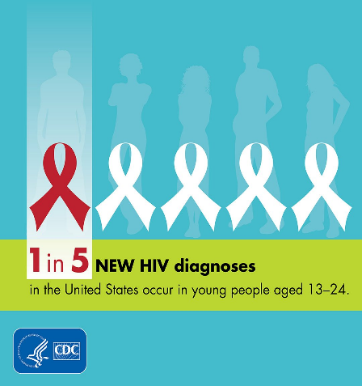
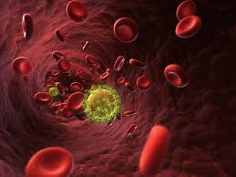
HIV and AIDS
Viral infection
Controllable with daily medication for life
More than 1 million individuals with HIV
Approximately 20% of these individuals are unaware of their positive HIV status
Spread through vaginal, oral or anal intercourse through bodily fluids
Blood, semen, vaginal secretions
Childbirth (with untreated infection)
Injection drug/sharing needles

Slide 19
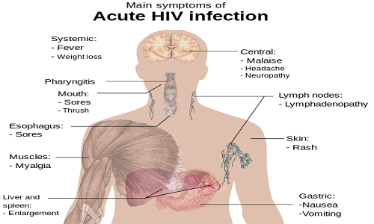
Acute HIV Infection
Fever and flu-like symptoms
Lasts 2-4 weeks
Can be mild - severe

Slide 20
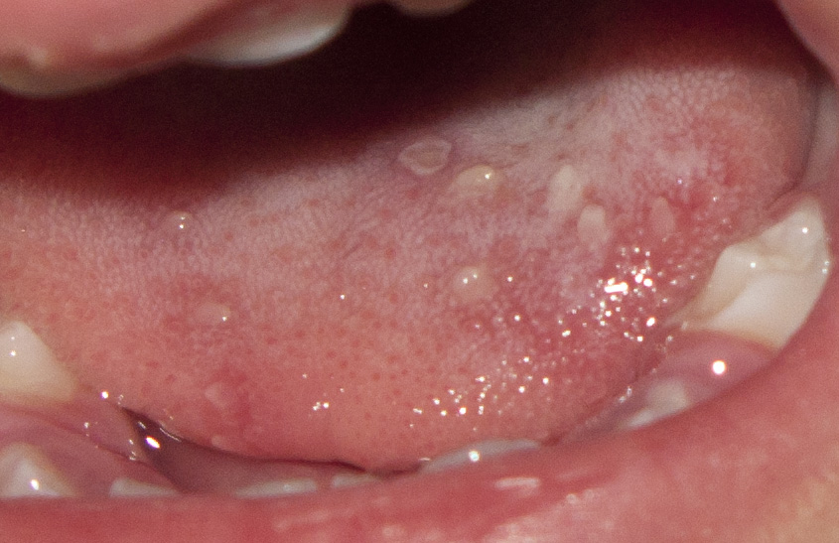
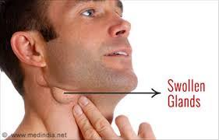
HIV Symptoms - Chronic
Heavy night sweats
Persistent tiredness
Rapid weight loss
Fevers that come and go
Swollen glands
White spots and/or sores on tongue, mouth or throat

Slide 21
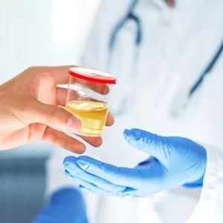
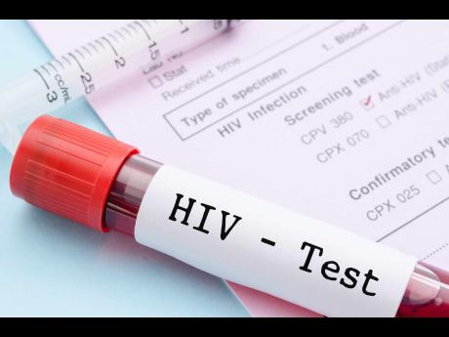
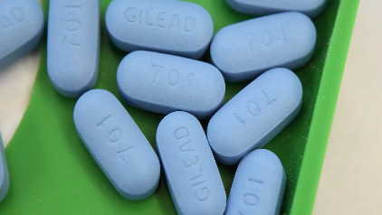
Testing and Treatment
Blood test most common
Saliva or urine tests are options
Repeat testing 3 months later
Anti-HIV drugs called “antiretroviral”
Attempts to reduce the amount of HIV in the body
Medication taken for duration of life

Slide 22
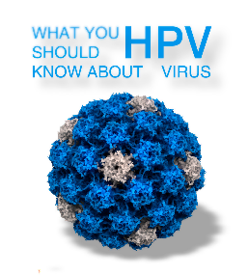
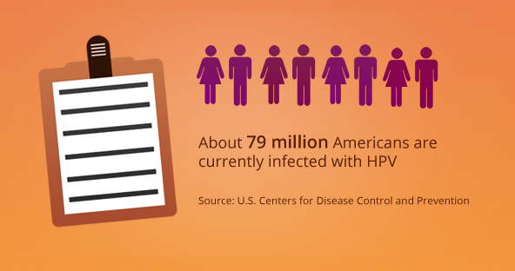
Genital Warts (HPV)
Viral, not curable
More than 70% of Americans will acquire HPV at some point in their lives
Over 14 million new infections yearly
More than 79 million currently infected
Transmitted through direct skin-to-skin contact
Approximately 40 types of HPV are sexually transmitted
Notes:
It is possible to be infected with more than one strain of HPV.
Can be transmitted even with out visible warts on the skin.

Slide 23
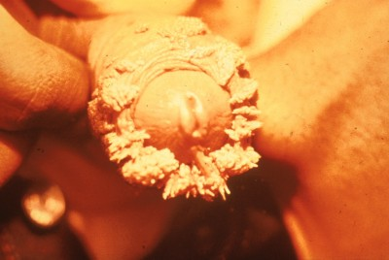
HPV Symptoms
Pronounced Genital wart/HPV infection. Probably ignored for many months.
Soft, moist, pink, red, white or flesh colored growths
Can be raised or flat, single or multiple, small or large
Can appear on the vulva, in or around the vagina or anus, cervix, penis, scrotum, groin or inner thigh
Rare: itching or burning
Many people with genital HPV do not know they have it
Notes:
Genital HPV/Warts tend to be small, multiple and flesh colored. They can be very difficult to find.

Slide 24
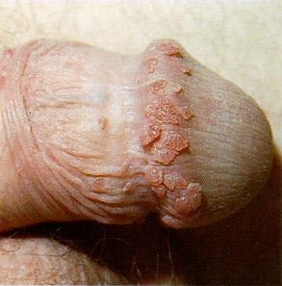
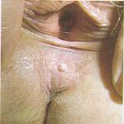
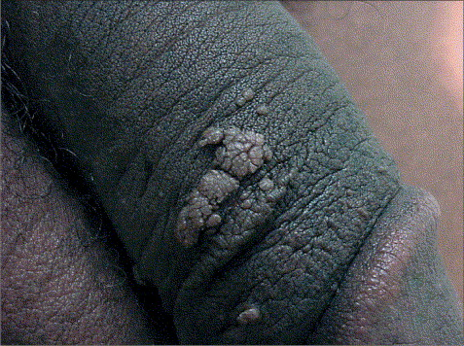
Typical Genital wart/HPV infection
Notes:
More typical cases seen in clinics or physicians offices.
Note the female may have been treated for warts prior to this and this is a recurrence of her initial infection.
25% of individuals with visible Genital Warts will have a recurrence within 3 months of treatment.

Slide 25
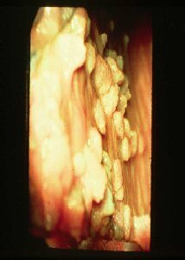
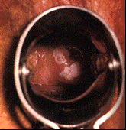
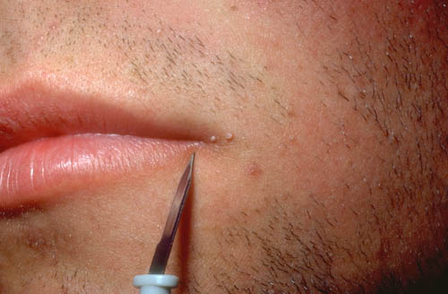
Around the mouth
On the vaginal wall
On the cervix
Notes:
While the first picture looks like the warts are large, in reality they are small and would be very difficult to find without seeing a physician. If she were to have intercourse with a male partner he would likely NOT feel them.

Slide 26
HPV and Cancer
Approximately 10 strains of HPV have been associated with cervical cancer in women, penile cancer in men, oral and anal cancer in both genders
By 2020, HPV-related mouth and throat cancers will surpass HPV-related cervical cancer cases
Twice as likely to occur in men than women
More than 70% of the tumors in mouth/throat cancers have HPV present
Notes:
The vaccination is something for all young women to talk to their physician about. It can be expensive in a doctor’s office if insurance does not cover it. It is available at the MCHD for a reduced charge.
Gardasil is now approved in men/boys 9-26 and recommended, not required.
HPV is correlated with anal cancer and penile cancer as well. (Strain number 6, 11)

Slide 27
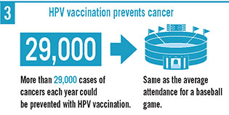
HPV Vaccination
Vaccine available to prevent four strains of HPV (6, 11, 16, 18)
These strains of HPV are responsible for 90% of genital warts and 70% of cervical cancer
It is recommended for boys & girls ages 9-14.

Slide 28
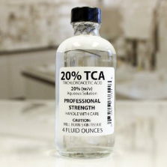
HPV Testing and Treatment
No routine screening blood test for virus.
There is pap test for females
There is NO cure for Genital Warts
Visible warts can be treated
Most common treatments:
Cryotherapy
Podophyllin
TCA (trichloracetic acid)
Surgery or laser treatments
Prescriptions
Notes:
Most cases (90%) of HPV infections go away within 2 years.
Treatment is outpatient and can take several applications depending on the severity of the wart growths.
Prescription medications are now available for in home treatment of warts. (Aldara)

Slide 29
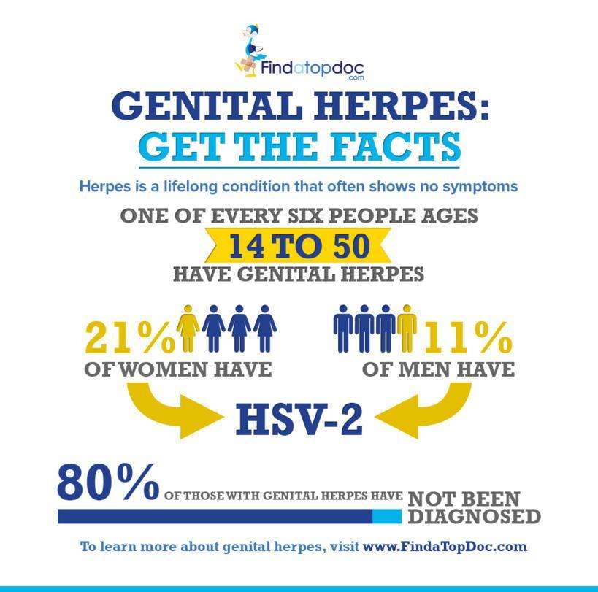
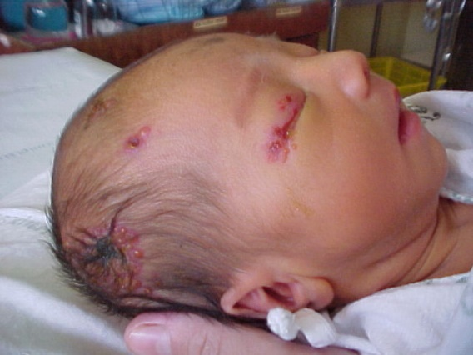
Genital Herpes (HSV 2)
Viral, not curable but controllable with long term medication use
Approximately 45-50 million people are infected, 1 million new cases per year
Spread through direct skin-to-skin contact with or without symptoms
Can be spread to a newborn during vaginal delivery
80% do NOT know they have the disease
Notes:
Highly contagious, with or without symptoms.
Most individuals do not know they are infected.
Newborns can be exposed during vaginal delivery. Most common during initial infection the mother. Newborns exposed to HSV-2 (genital herpes) can have severe infections in the eyes, skin, mouth and can be fatal if it infects the liver or brain.

Slide 30
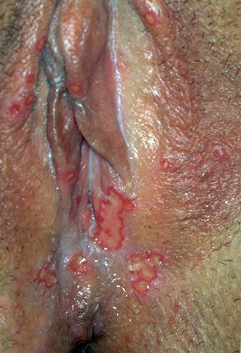
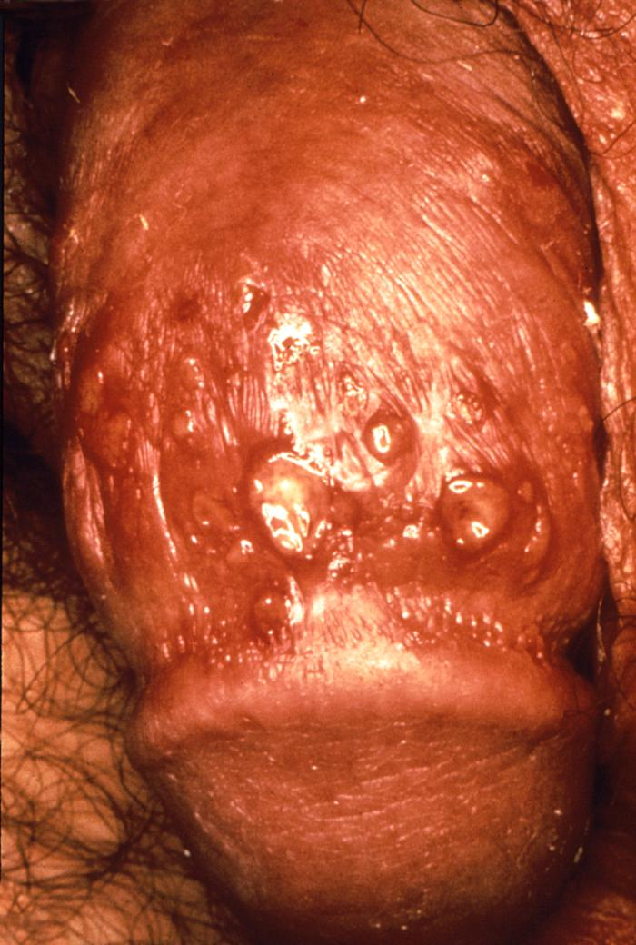
Genital Herpes (HSV 2) Symptoms
Outbreaks of genital herpes can vary greatly from person to person
During initial infection many people develop a fever and/or flu-like symptoms
Outbreaks begin with an itching, burning, tingling or pain in the genital area
One or more blisters appear, which typically break open into sores lasting 10-14 days
Most mild herpes outbreaks are mistaken for ingrown hairs, yeast or fungal infections, insect bites or razor burn
Notes:
Individuals infected with Genital Herpes only get the “flu-like” symptoms with initial infection.
The itching/burning/tingling sensation on the genitals is called the “prodromal” phase. You are VERY contagious in this stage.
Blisters heal in 5-14 days depending on severity of infection.
Most individuals infected with Genital Herpes have no idea! It is easy to mistake mild symptoms for other infections.
Images: Primary infection with HSV-2 or Genital Herpes.

Slide 31
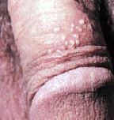
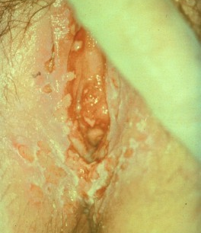
Genital Herpes infection

Slide 32
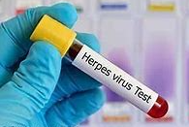
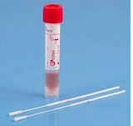
HSV Testing and Treatment
Testing done through a blood test, sample from sores or physical exam
There is NO cure for Genital Herpes
Outbreaks typically recur during periods of stress or illness throughout an infected person’s lifespan
Several antiviral medications can shorten and help reduce the frequency of outbreaks
Notes:
The virus lives in the nerve cells and tends to recur during periods of stress or illness (weakened immune system).
Antiviral medications can help alleviate symptoms. They have not been shown to definitively stop the spread of the virus from one person to another.

Slide 33
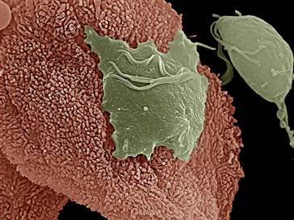
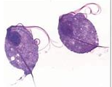
Trichomoniasis
Trichomoniasis parasite (green)
Curable, caused by a parasite
3.7 million new cases nationwide
Transmitted through vaginal, oral or anal intercourse with an infected partner
Trichomoniasis parasite (stained)
Notes:
Picture of a Trichomoniasis parasite (green), attached to a vaginal epithelial cell (pink).
Bodily fluid disease

Slide 34
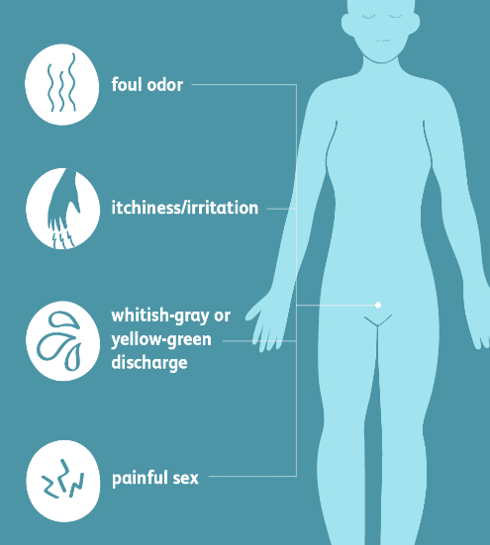
Trichomonas Symptoms
Women:
Yellow, green or grey vaginal discharge that has a foul smell
Vaginal itching
Painful sexual intercourse
Men:
Typically no symptoms
Rare: pain when urinating or mild discharge
Notes:
Women tend to have distinct symptoms as noted above. The discharge is an unmistakable greenish-yellow color.
It is not uncommon for individuals infected with Trichomoniasis to be infected with other STI’s. Notably Gonorrhea.

Slide 35
Trichomonas Treatment
Testing through a swab sample or urine
Curable with antibiotics
Finish all medication prescribed even when symptoms improve
All sex partners must be treated
Reinfection rates are high (males unknowingly pass on disease)
Notes:
Both partners must be treated to eliminate re-infection with the parasite.

Slide 36
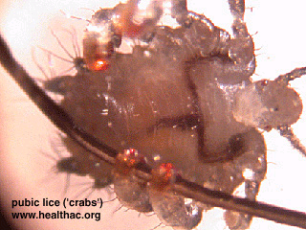
Scabies and Pubic Lice
Scabies is a curable skin disease caused by a parasite
Transmitted through close physical contact with an infected person
Symptoms: itching and a pimple like rash
The only way to know if someone is infected is with a test (skin scraping)
Treated with Rx lotions/creams
Pubic lice (crabs) are small parasites that feed on human blood
Transmitted through close physical contact
Symptom (itching) usually starts with in 5 days
Treated with OTC creams
Notes:
Small picture is scabies parasite.
Rash on penis is from scabies.
Picture of a pubic lice (crab).

Slide 37
Reducing the Risk of STDs
No Risk
Reduced Risk
Abstinence (sex): not having oral, vaginal or anal sex
No genital contact
Mutual monogamy between non-infected partners
Protected Sex: “Correct and consistent” use of condoms/barriers
Fewer sexual partners
Regular STD testing

Slide 38
Do’s and Don’ts for Male Condom Use

Slide 39
Female/Insertive Condom Use

Slide 40
STD Testing
Regular screening and repeat testing is recommended in sexually active teenagers and young adults.
FREE testing and treatment at the Macomb County Health Department STD clinic. Appointment necessary.
Call for more information: 586-465-9217
Website: Health.macombgov.org/Health-Programs-HPDC-STDProgram
Can get tested as early as 12 years old without parent consent.
Our services are confidential and no charge for services.

Slide 41
Macomb County Health Department STD Clinic
Services provided include:
Risk Assessment Counseling
Free Condoms
Informational Pamphlets
Testing and treatments
Confidential/Anonymous Rapid HIV testing (Results in 20 minutes)
Referrals for other community health services
We provide testing and treatment for:
Syphilis
Gonorrhea
Chlamydia
Non-gonococcal urethritis (NGU)
Trichomonas's
Scabies (Treatment only)
Hepatitis C (Testing only)
Rapid and Conventional HIV (Testing only)
Point of Testing may include:
Anal
Oral
Penile
Cervical
Blood draws
Urine
Vaginal
STD clinic does NOT provide testing or treatment for Bacterial Vaginosis, Herpes, Genital warts (HPV), PAP smears, Urinary Tract Infection (UTI)

Slide 42
Summary
Abstinence is the only way to protect 100% against all STDs
Many STD do not have symptoms – check if sexually active
If a person has been sexually active, the only way to know if they have an STD is if he/she is tested.
If you choose to be sexually active, the only ways to reduce your risk is to use a latex condom and be in a monogamous relationships with fidelity
Macomb County Health Department STD Program 586-465-9217

