Slide 1
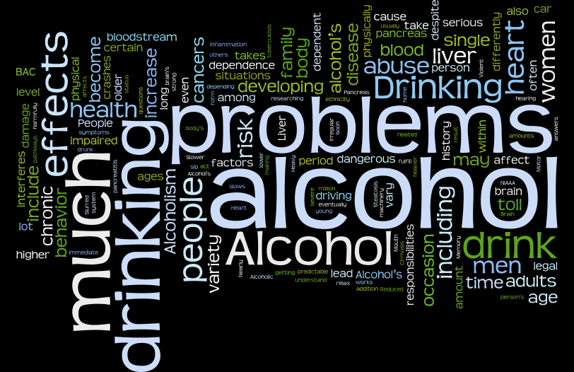

Slide 2
Facts About Alcohol
You may not think alcohol is a drug, but IT IS!
A drug is any chemical substance that is taken to cause changes in a person’s body or behavior.

Slide 3
Alcohol is a Depressant
A depressant is a drug that slows brain and body reactions.
In slowing the body’s normal reaction, alcohol may cause…
Confusion
Decreased Alertness
Poor Coordination
Blurred Vision
Drowsiness

Slide 4
Risk of Underage Drinking
Being injured or killed in a motor vehicle accident.
Committing or being the victim of a sexual assault or other violence.
Potential to suffer from long term brain damage.
Problems with alcohol later in life.
Suspension from school, sports teams, or other activities.

Slide 5
Drinking and Driving Statistics
17x
1 in 10
2.4 million
People of ages 16-20 are 17 times more likely to die in a crash when their blood alcohol concentration is .08 than when they have not been drinking.
1 in 10 teens in high school drinks and drives.
Across the United States, high school teens drive after drinking 2.4 million times a month.

Slide 6
Legal Risks of Underage Drinking
First Offense | Second Offense | Third Offense
Fine of $100 Substance Abuse Treatment Community Service | Fine $200 Substance Abuse Treatment Community Service 30 days jail if violation of probation, or failure to complete treatment, pay fine | Fine $500 Substance Abuse Treatment Community Service 90 days jail if violation of probation, or failure to complete treatment, pay fine
Laws that prohibit minors from buying or possessing alcohol are enforced with heavy fines and lawful seizure of property.
Selling alcohol to someone under the age of 21 is a criminal offense for the seller.
People found to be driving while intoxicated may have their driver’s license taken away or face other stiff penalties.
MIP Law

Slide 7
Developing Refusal Skills
Give a reason for your refusal.
Use body language to reinforce what you say.
Strengthen or weaken your message.
Show your concern for others.
Express your concern for those trying to persuade you.
Provide Alternatives.
Take a definite action.

Slide 8
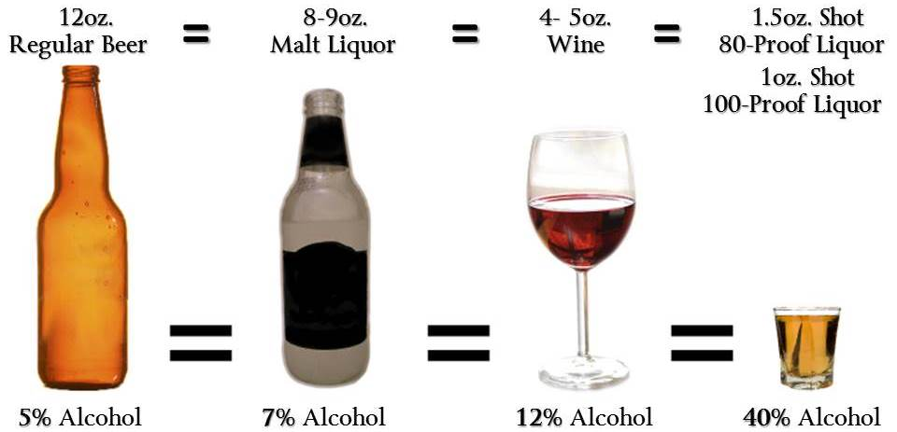
Standard Drinks
In the United States a standard drink is equivalent to 14.0 grams or 0.6 ounces of pure alcohol.
This amount can be found in…
12-ounces of beer
8-ounces of malt liquor
5-ounces of wine
1.5-ounces of 80-proof distilled spirits or liquor

Slide 9
Blood Alcohol Concentration (BAC)
Blood Alcohol Concentration – The amount of alcohol is someone’s blood.

Slide 10
Factors Affecting BAC
Legal BAC is .08
Gender
Males will generally have a lower BAC level than females.
Rate of consumption
People who have a few drinks in one hour will have a higher BAC than people who consume the same amount of alcohol over a longer time period.
Amount of food in the stomach.
Drinking on an empty stomach increases alcohol absorption into the bloodstream.

Slide 11
Effects on Behavior
When intoxication takes effect…
Drinkers begin to lose judgment and self control.
At the same time, alcohol decreases drinkers’ natural fears.
A blackout is a period of time the drinker does not recall.

Slide 12
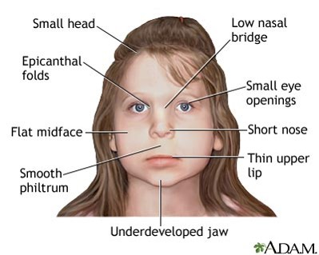
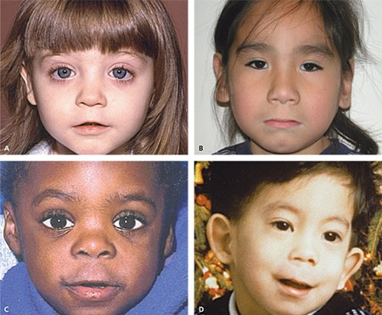
Damage to the Body
Long term alcohol abuse may harm the…
Drinking any amount while pregnant may…
Brain
Liver
Heart
Digestive system
permanently harm the developing baby.
cause the baby to develop fetal alcohol syndrome.

Slide 13
Effects of Alcohol on the Body
Cardiovascular System
Nervous System
Heart rate and blood pressure increase.
More blood flows to the skin’s surface.
Core body temperature decreases.
Brain activity slows down.
Coordination becomes impaired.
Sensations and perception become less clear.
Reflexes become sluggish.
Excretory System
Kidneys increase urine production.
Drinker loses more water from body than usual.
Digestive System
Too much alcohol in the stomach may cause vomiting.

Slide 14
Alcohol Poisoning
Alcohol Poisoning is a condition in which toxic amounts of alcohol are consumed usually over a short period of time.
BAC is so high that it is considered poisonous.
Can be life threatening.

Slide 15
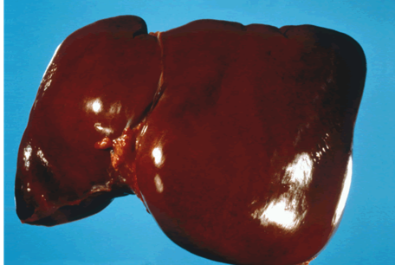
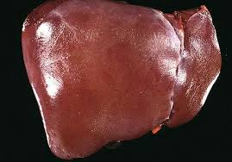
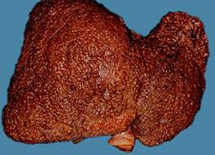
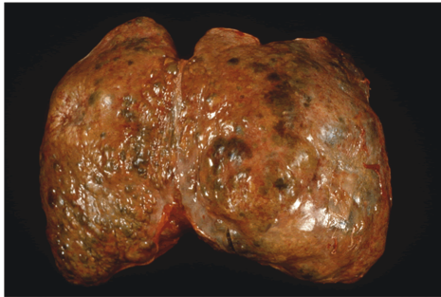
Liver Damage
Alcohol interferes with the liver’s ability to metabolize, or break down fats.
Fat-filled liver cells die, leaving behind useless scar tissue.
This disease is called cirrhosis (sih-ROH-sis), may lead to liver failure and death.
Healthy Liver
Liver with Cirrhosis

Slide 16
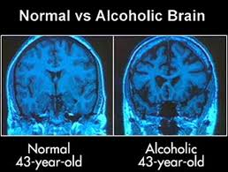
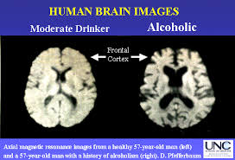
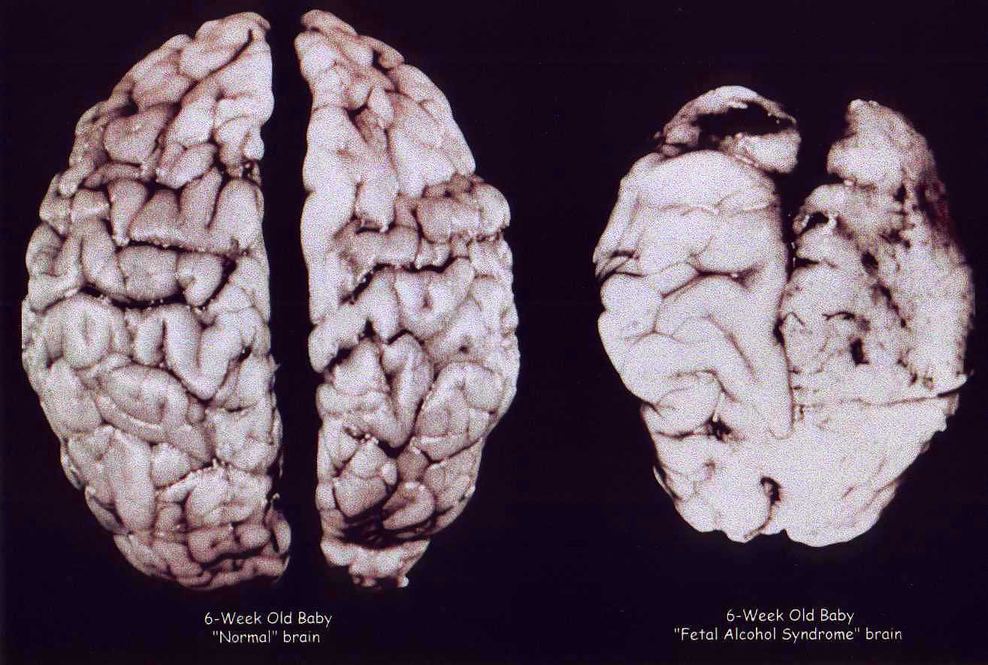
Alcoholism
People who can no longer control their use of alcohol suffer from the disease of Alcoholism.
Physically, an alcoholics body requires alcohol to function.
Psychologically, alcoholics consider drinking a regular, essential part needed to cope with everyday life.

Slide 17
Alcoholism and the Effect on Family

Slide 18
Treating Alcoholism
There are three stages in treating alcoholism…
1. Acknowledging the problem
The shock of losing their jobs, being arrested, or being separated from their families motivates some alcoholics to enter into a treatment program.
2. Detoxification- Removing all toxins from a persons body
Symptoms- shakiness, sleep problems, irritability, rapid heartbeat, and sweating.
3. Rehabilitation- The process of learning to cope with everyday living without alcohol.

